Slide 1
LEGOLAS Raspberry Pi & Buildhat Setup Guide

Slide 2
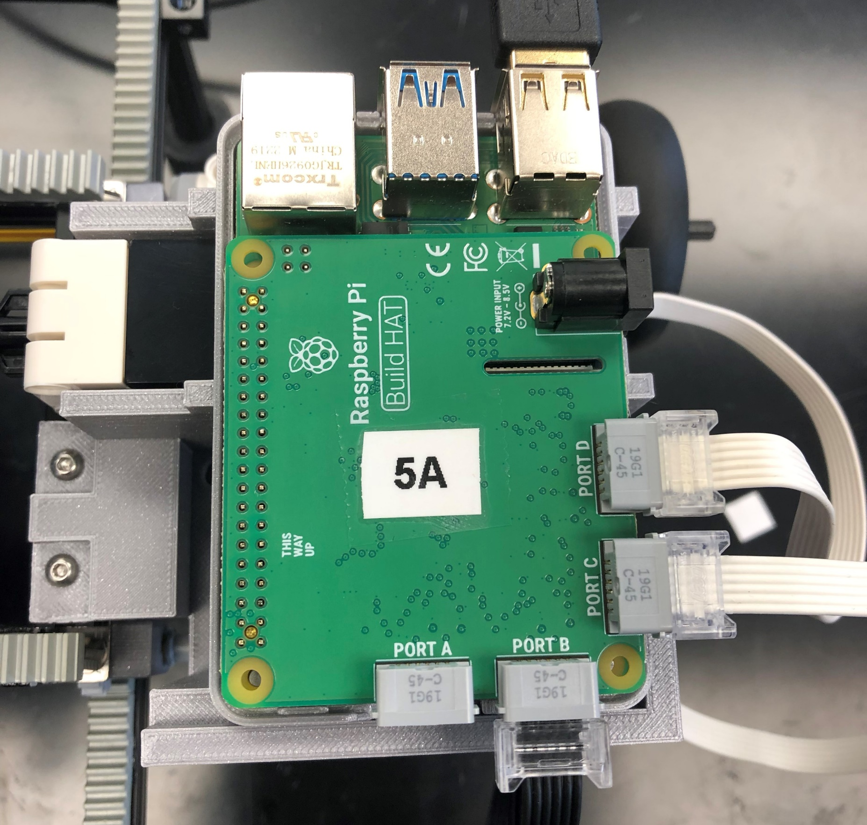
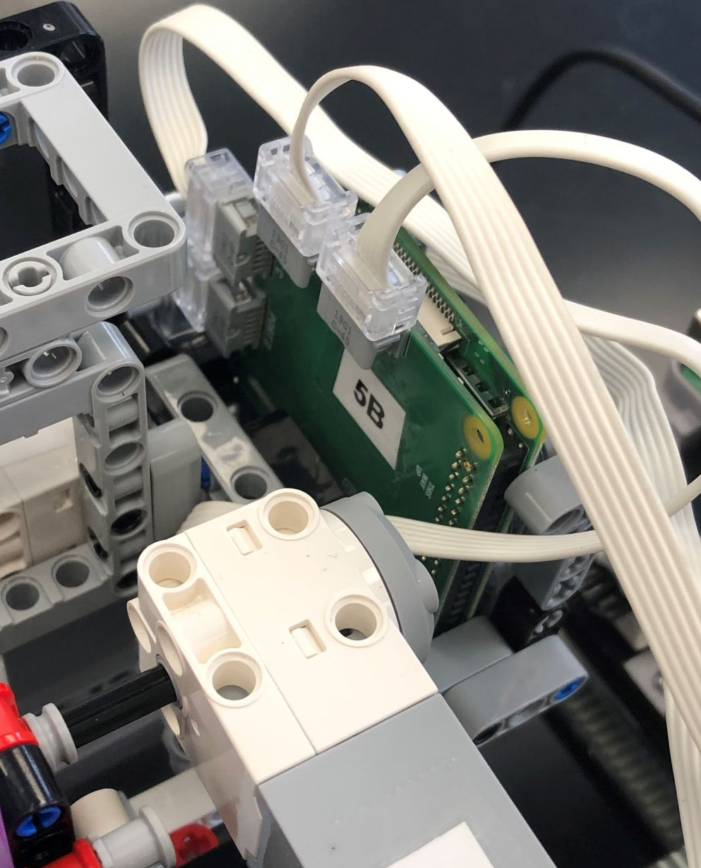
You will have two Raspberry Pi + Buildhat stacks, one which is located on the side assembly of the bridge (#A), and another which is located on the trolley (#B). Each contains a microSD card. The following steps may be applied to both microSD cards to prepare the R-Pi + BH for use in LEGOLAS. However, if you have a USB microSD Card Reader, you may also just follow the steps for one of the R-Pi + BH microSD cards, and then use the “SD card copying” accessory to copy the setup to the other microSD card (see Step 8)

Slide 3
Items Needed
(1x) USB MicroSD Card Reader (optional)
(1x) Monitor
HDMI Input: You will need an HDMI → microUSB cable
VGA Input: You will need a VGA → HDMI & a HDMI → microUSB
(1x) Keyboard (USB Input)
(1x) Mouse (USB Input)
(1x) Buildhat Charger
(2x) R-Pi + BH w/ microSD stacks
(1x) WiFi Router (TP Link used in this example)
(1x) Ethernet → Ethernet Cable
You can Also Follow tips here to help Supplement this Guide
BuildHAT Installation: https://www.raspberrypi.com/documentation/accessories/build-hat.html
BuildHAT Documentation: https://buildhat.readthedocs.io/en/latest/buildhat/index.html
BuildHAT Website: https://www.raspberrypi.com/products/build-hat/

Slide 4
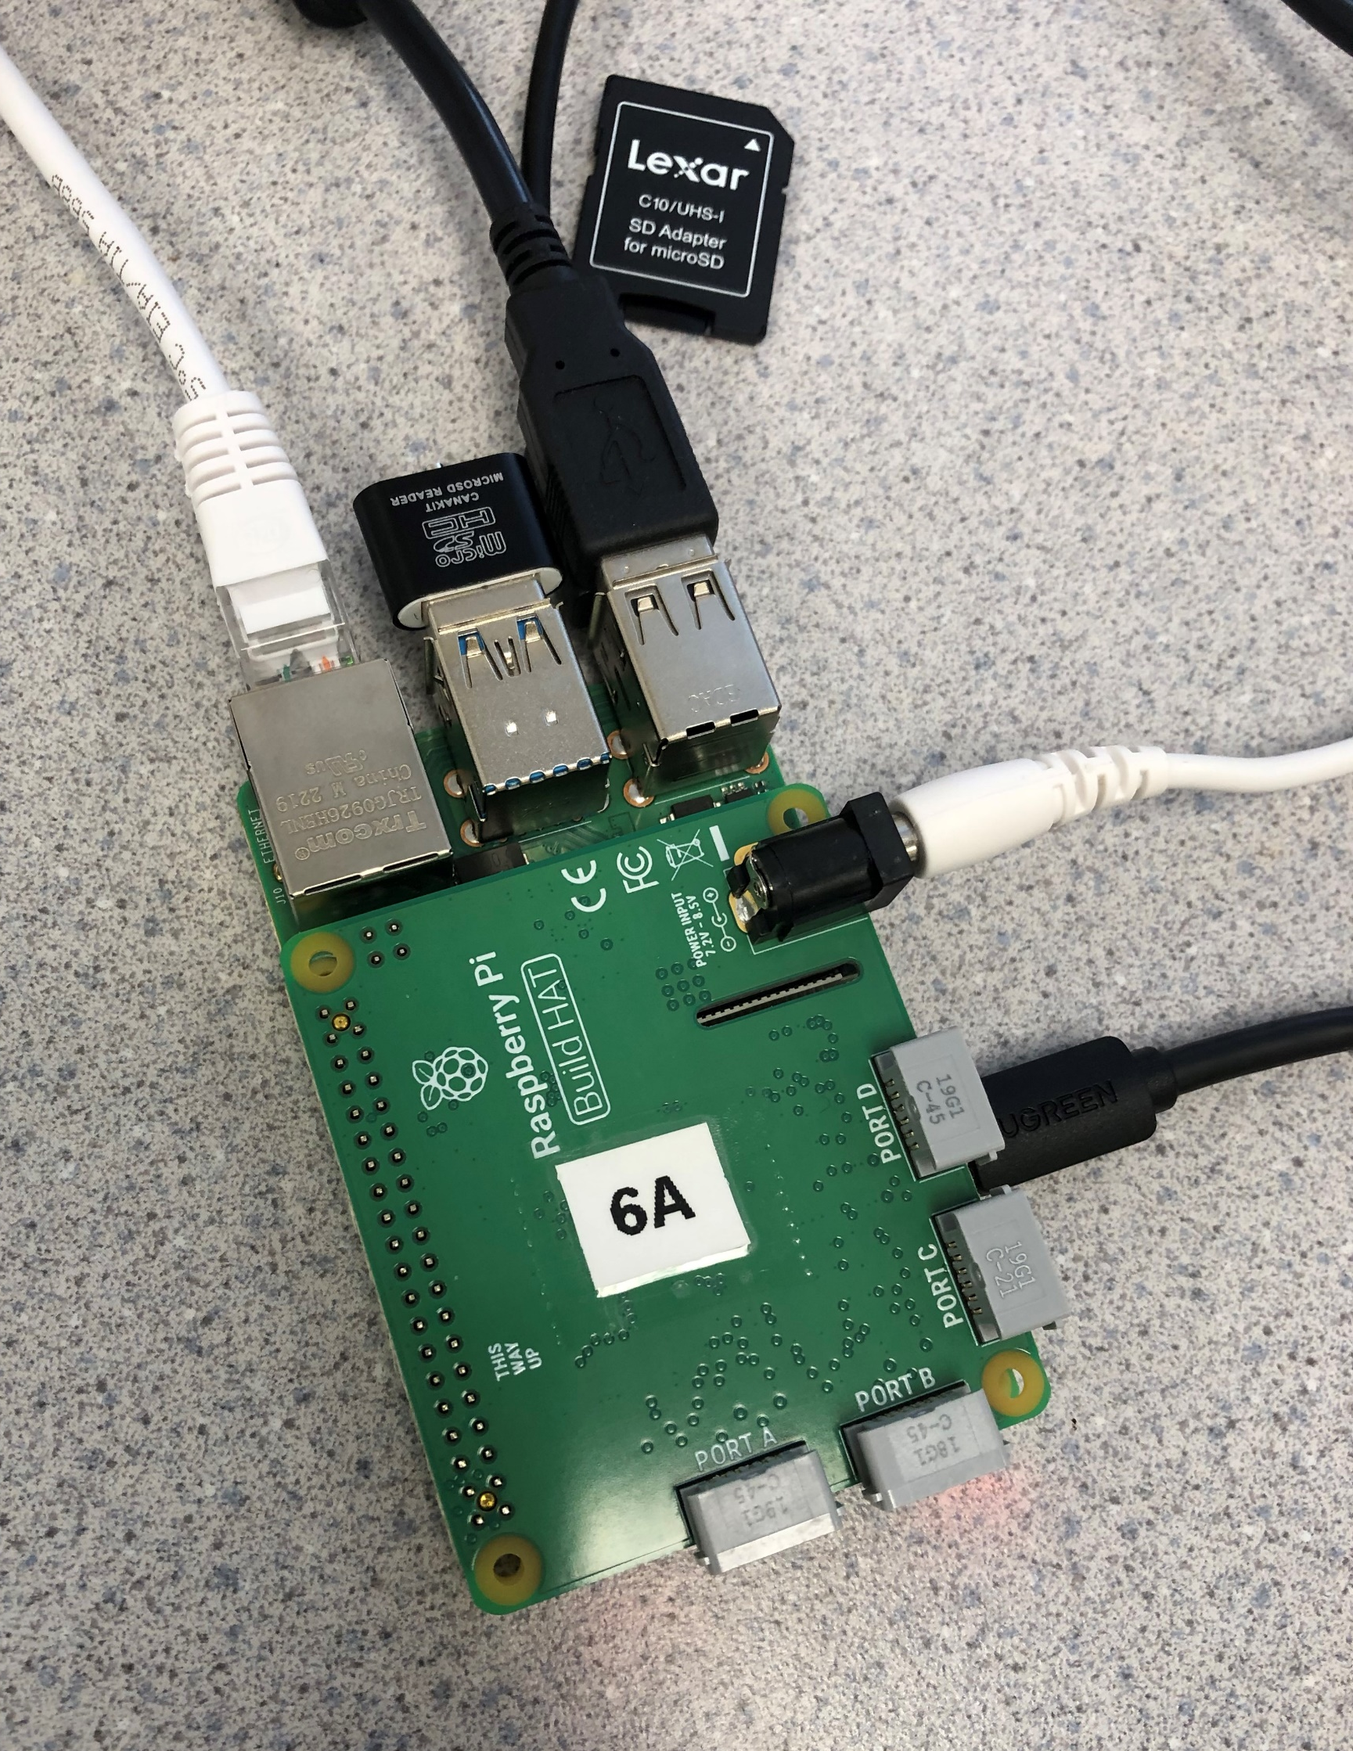
1. Wiring
Mouse
Keyboard
Ethernet to Router
Connect the first stack to the required cables as shown. The microSD reader is there only if you are now copying the setup microSD to the second stack’s microSD card (go to Step 8). Once the stack is receiving power and the monitor is displaying images, go onto the next step.
microSD Reader
BH Charger
microUSB to Monitor

Slide 5
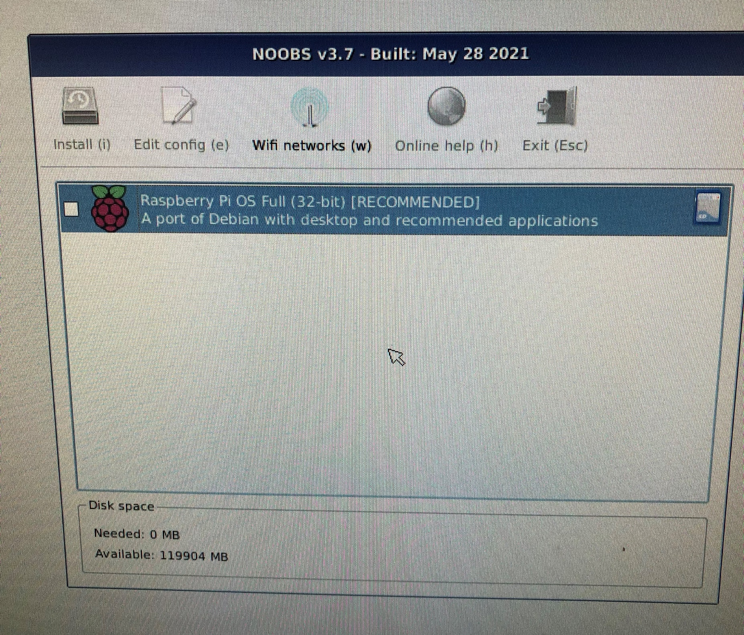
2. Install R-Pi Operating System & Connecting to WiFi
If the R-Pi was purchased with an SD card, it will likely have the Operating System downloaded. If not, follow the documentation to ensure it is downloaded on your compatible microSD card. Once plugged in, it will display this screen on the monitor. Select the R-Pi OS and click “Install.” This will likely take around 15-20 minutes to complete.
After the OS is installed, ensure you have your local WiFi router set up, and connect via password to your network. You may need to have the ethernet cable connecting the raspberry-pi to the router physically.

Slide 6
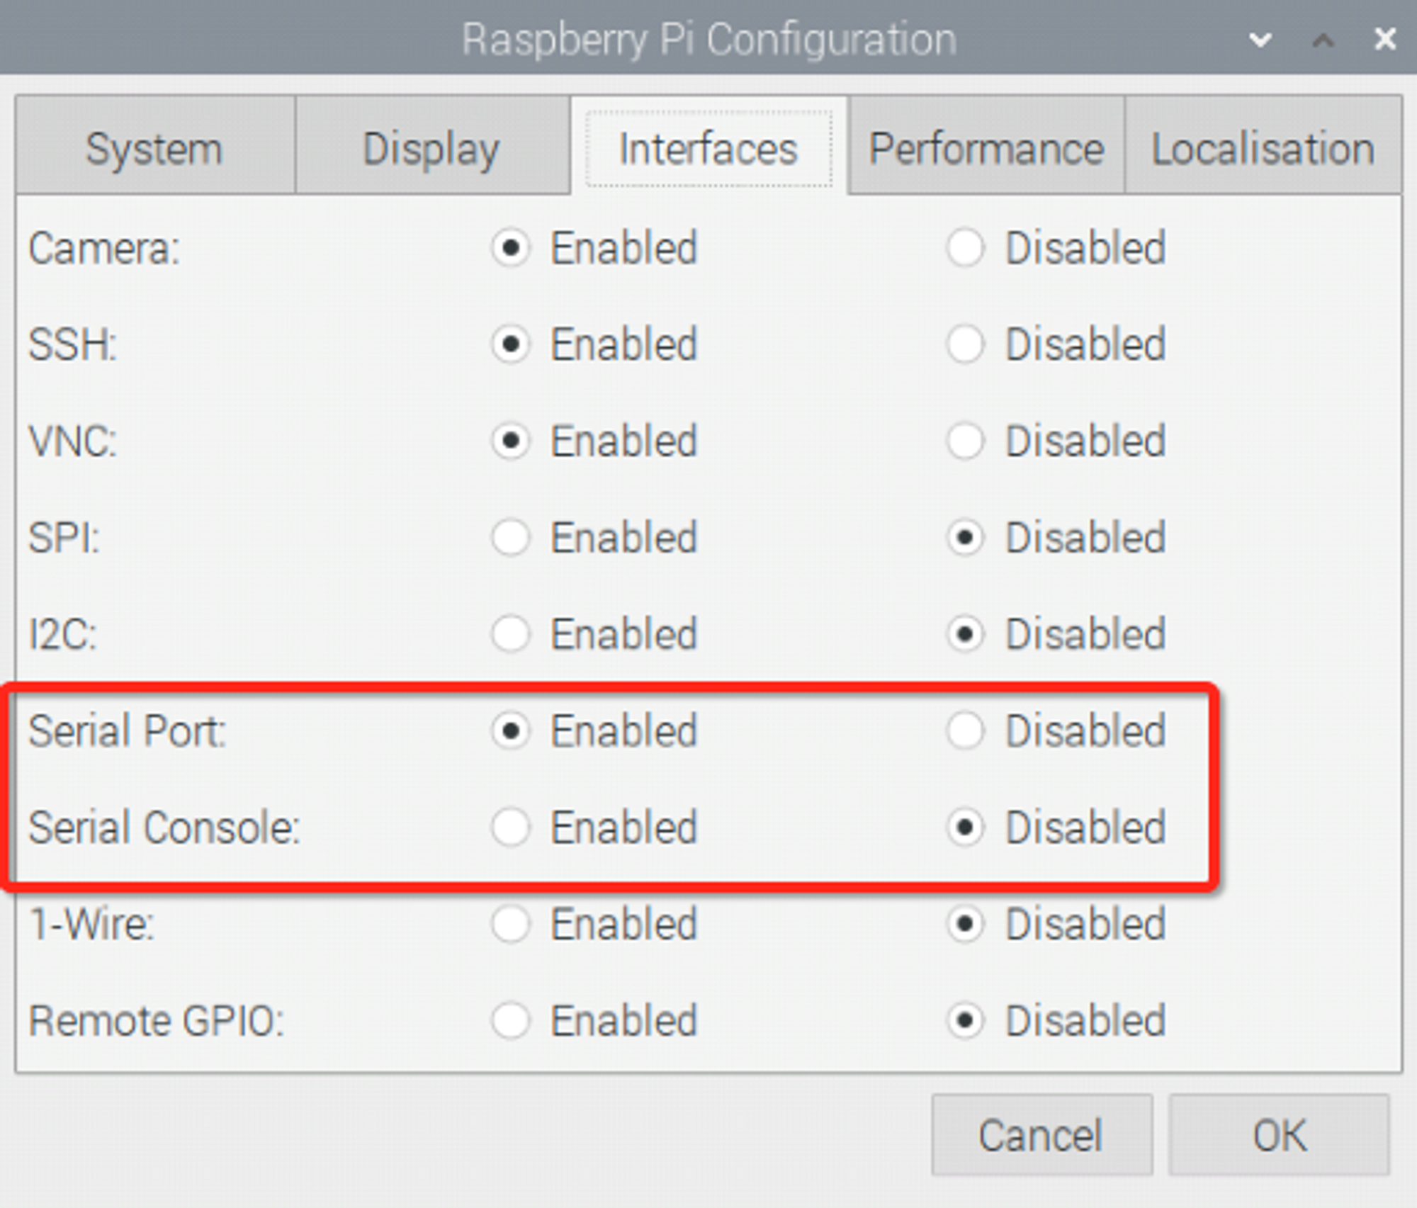
3. Configure and Assign a Hostname to R-Pi
Once at the R-Pi Home Screen, select Preferences → Raspberry Pi Configuration from the dropdown and go to the Interfaces tab. Change the setup so that it matches the picture to the right, taking care to disable the Serial Console option as well. Press OK and choose not to reboot. Go to the System tab within the Configuration tab and rename your Raspberry-Pi on the hostname line (ex: raspberrypi5B). This is the name that will appear when you are reserving the address of your R-Pi on your local router. After renaming the R-Pi, reboot it.

Slide 7
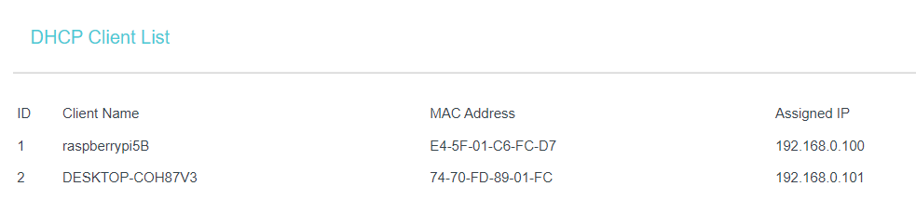
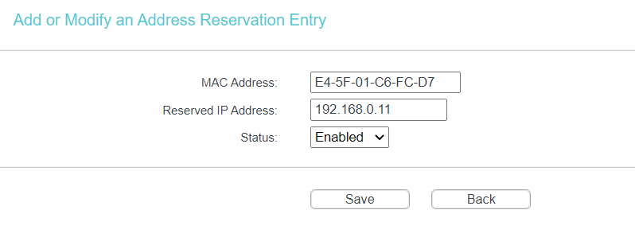
4. Fix IP Address in Router
Ensure your laptop or computer is connected to the same WiFi network as the Raspberry-Pi, and go to the Router Management Site (ex: for TP Link it is tplinkwifi.net). Login with the password and/or network name, and find the MAC address associated with the R-Pi hostname you set earlier (This will be on the DHCP Client List). Copy this MAC address, and use it to add a new address to your address reservations list.
Set an IP address for which it will be associated with (ex: 192.168.0.11). Remember this IP address, as it will be your means of controlling the R-Pis later on for calibration and experimentation.

Slide 8
5. Install Buildhat & RPyC Packages
Commands
mkdir -p ~/git
cd ~/git
pip3 install buildhat
pip3 install rpyc
git clone https://github.com/tomerfiliba-org/rpyc.git
We will need to install the BuildHAT package so we can interface with the LEGO motors, and we must install the RPyC package so we can remotely control the R-Pi + BH stack.
If your local wifi router does not have internet access, connect instead to a network with internet access. Go back to the monitor in which you are interfacing with the R-Pi & type ctrl+alt+t
to open the command prompt. Enter the code to the right, line by line.

Slide 9
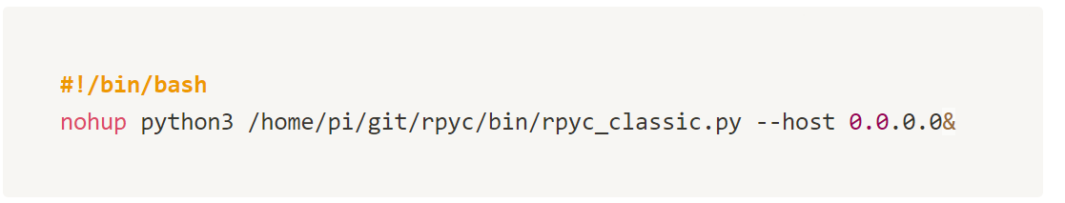
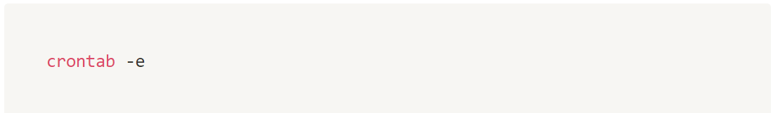
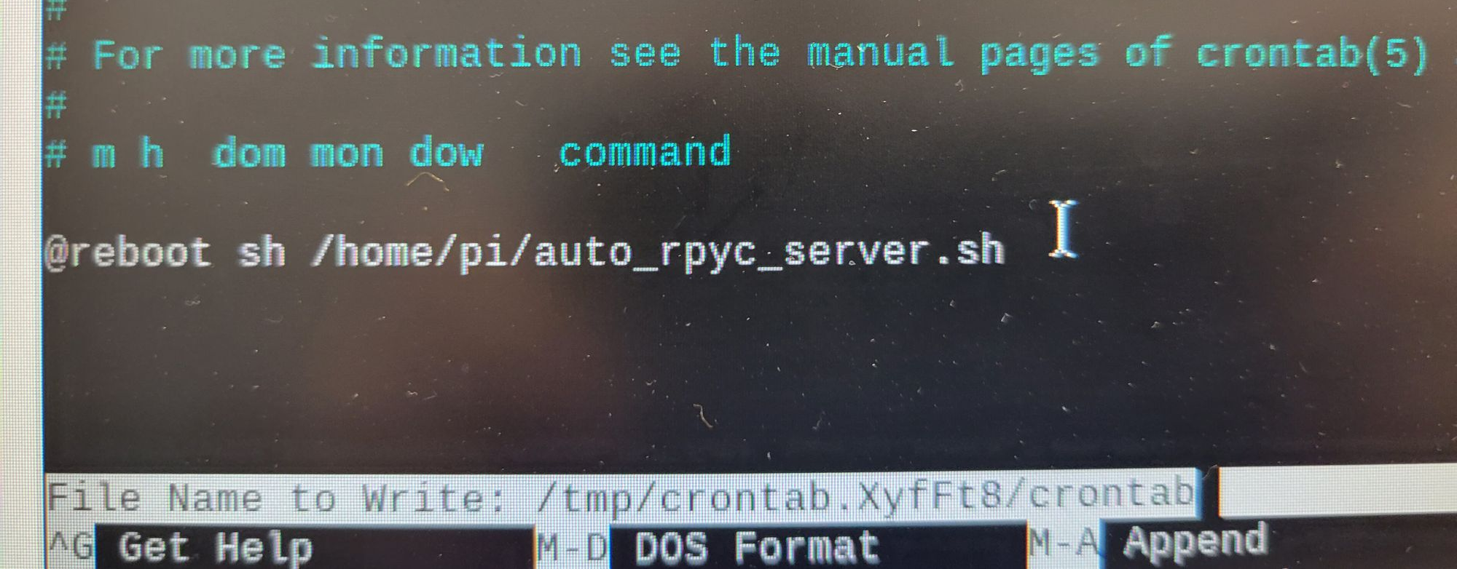
6. Setting up an Automatic RPyC Server
Next, we will setup the Raspberry-Pi so that it automatically opens an RPyC Server upon being rebooted.
In the same command prompt window, add these lines:
This creates a rpyc server to be kept open in the background upon rebooting the R-Pi.
Next, type the following line:
Then, enter 1 to edit in nano
Lastly, in the editor, scroll to the bottom of the file and type this line (@ reboot…)
Ctrl + X and type Y to save and exit.
Enter exit into the command window to exit, and reboot the R-Pi.

Slide 10
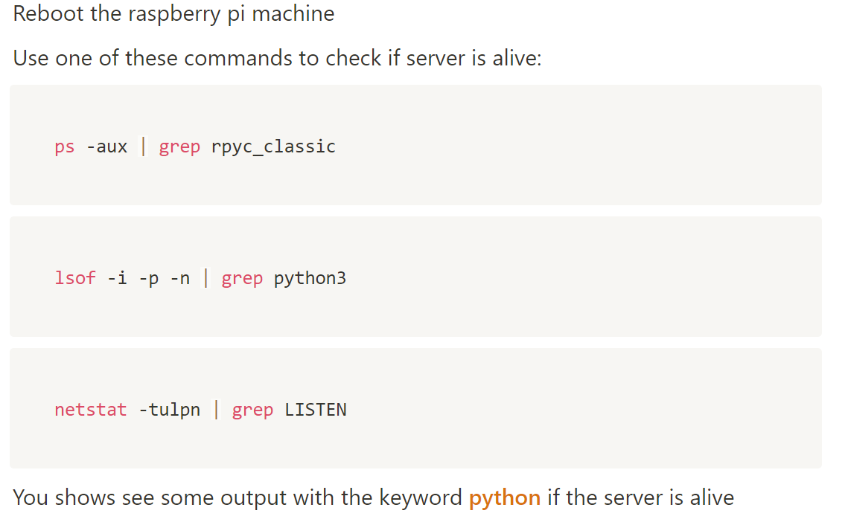
7. Verify the Server is Working

Slide 11
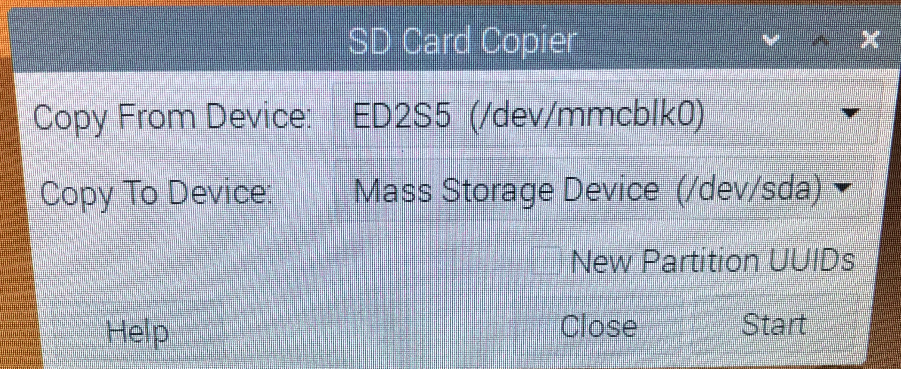
8. Copy to new SD Card (Optional)
Steps 1-7 may be repeated for the second R-Pi, or if you have access the USB microSD Reader, you can copy the microSD card you just setup to the new R-Pi’s microSD card.
Enter the new SD card into the USB reader and insert this into the R-Pi you just set up (see Step #1 for location), keeping the initial microSD card inserted into the R-Pi’s designated slot.
From the monitor, click on the dropdown and select Accessories → SD Card Copier and select the information shown in the image to the right. Confirm that you would like to overwrite the SD card and continue.
Once it is finished transferring, shutdown the R-Pi, remove the new microSD card from the USB reader, and insert into the new R-Pi stack. Then, hook this R-Pi up to your monitor, set a hostname for it (Step 3) and fix its address in your router (Step 4).

